Slide 1
Capital Outlay Request Process 2025
Michelle Jaschke
Capital Outlay Programs Coordinator
Legislative Council Service
November 6, 2024

Slide 2
Agenda
Capital Outlay Project Parameters and Funding Sources
Capital Bills Overview
LCS Capital Outlay Project Request Website and Search Functions
Capital Outlay Request Process for Legislators
Anti-Donation Clause
House and Senate Rules

Slide 3
Capital Project Parameters and Funding Sources
The Property Control Act defines a capital outlay project as the acquisition, improvement, alteration or reconstruction of an asset of a long-term character
- and further, that a capital outlay project includes all of the proposed expenditures related to the entire undertaking; for example, if you are building an equipment storage facility, you can plan, design, construct and equip that facility.
Funding Sources
Severance Tax Bonds
General Fund
General Obligation Bonds

Slide 4
Capital Outlay Bills
Capital Projects Bill
Introduced as “statewide” projects
Substituted in committee to include members’ funded projects
Capital Project Reauthorizations
Time extensions, change of scope, change of agency
Project may only be reauthorized for a two-year period
General Obligation Bond Bill
Produced every other year
Includes ballot initiatives for senior centers, higher education, libraries

Slide 5
Capital Outlay Project Request Website
LCS website collects project requests from eligible entities
https://www.nmlegis.gov/CapitalOutlayWeb/
Site opened 10/17/24 and will close 12/13/24
Projects must be submitted by the deadline to be considered for funding
Search Functions:
Use the LCS Web ID or a keyword to access project summary sheets
Use the Submitted Projects Search to search by entity or by county
Governor’s request site: https://www.governor.state.nm.us/request-capital-outlay/

Slide 6
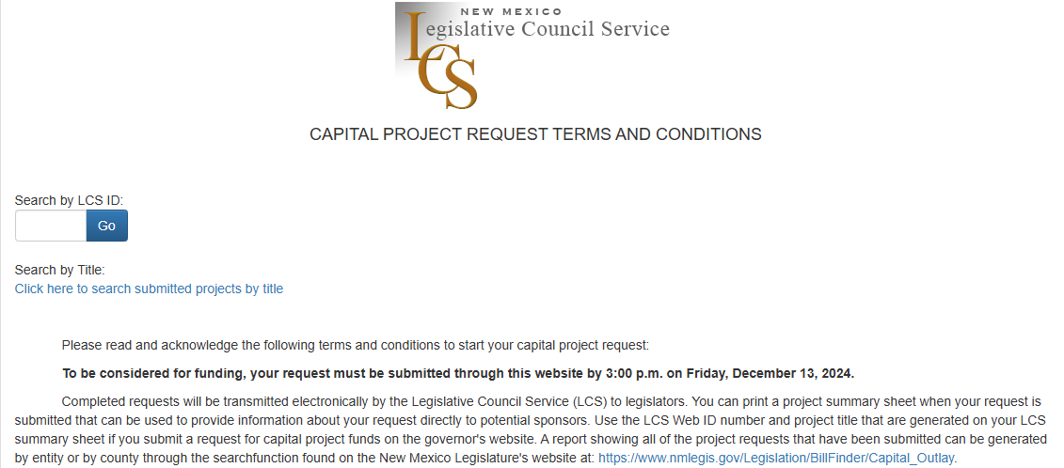
https://www.nmlegis.gov/CapitalOutlayWeb/Default

Slide 7
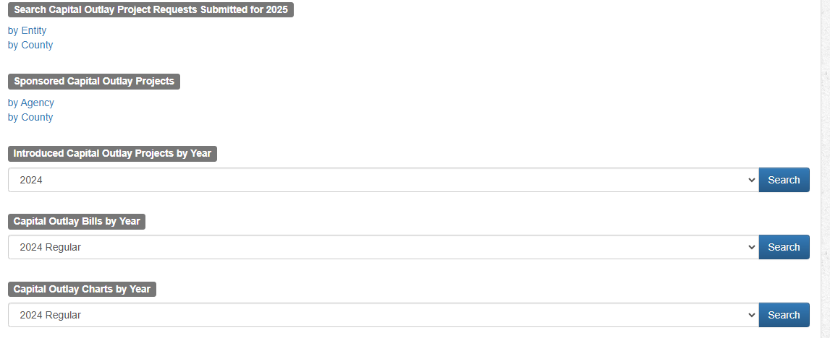
https://www.nmlegis.gov/Legislation/BillFinder/Capital_Outlay

Slide 8
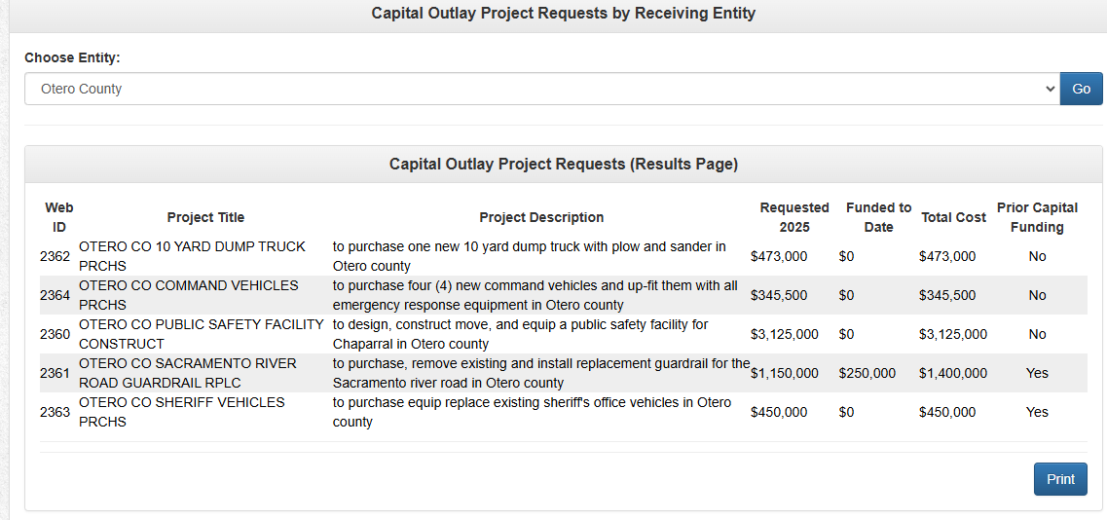

Slide 9
Request Process for Legislators
Members select sponsored projects
The sponsored projects list is used to create members’ Capital Outlay Requests (CORs) that are read into the record at the introduction deadline
CORs are subject to the requirements for bill introduction
CORs are then used to create members’ funding sheets
Funding guidance goes out to members
Funding information becomes public 30 days after end of session

Slide 10
Funding Guideline Reminder
Members are strongly encouraged to fund projects at no less than $100,000 to ensure that funding is used effectively to strengthen the state's infrastructure.
The funded amount can be less only if the funding will complete an existing project or if the funding will fully fund a new project or project phase.

Slide 11
Anti-Donation Clause
Article 9, Section 14 of the Constitution of New Mexico prevents the state from spending its money (or pledging its credit) to benefit private interests. Any asset to be acquired or constructed with capital project funding must be owned by the state or a political subdivision of the state.
Local governments as fiscal agents
Lease or other contractual agreements

Slide 12
House and Senate Rules
House and Senate rules provide that one capital outlay expenditures bill will be introduced and one general obligation bond bill may be introduced in the house or the senate. The bills are then referred to the appropriate committee (SFC or HTRC). Except as provided in rule, any other request by a legislator to appropriate money for capital outlay projects shall be submitted as a capital outlay request prepared by the Legislative Council Service.
The rules do provide that a capital outlay request may be made by bill if there is broad legislative interest in both houses in the matter or if referral to several committees is desirable.

Slide 13
Capital Outlay Questions?
Contact us: (505) 986-4600
Michelle Jaschke
Capital Outlay Programs Coordinator
Legislative Council Service
(505) 986-4652
Michelle.Jaschke@nmlegis.gov
Sheila Keleher
Researcher
Legislative Council Service
(505) 986-4682
Sheila.Keleher@nmlegis.gov

