Slide 1
FIR TRAINING
FIR TRAINING SESSION
JANUARY 5, 2017

Slide 2
FIR TRAINING
WE NEED YOUR
HELP!

Slide 3
PURPOSE
FISCAL IMPACT REPORTS:
  PROVIDE INFORMATION AND NON-PARTISAN ANALYSIS TO LEGISLATORS AND THE PUBLIC ON IMPACT OF LEGISLATION BEFORE A BILL BECOMES LAW
  DESCRIBE THE IMPACT OF A BILL ON THE FINANCES OF THE STATE GOVERNMENT CUMULATELY AND OBJECTIVELY, SO THAT, THE LEGISLATURE CAN MAKE INFORMAL DECISIONS ON 1) COSTS, 2) SAVINGS AND 3) REVENUE
  ALLOW FOR TRACKING LEGISLATION THAT MAY IMPACT THE GENERAL APPROPRIATION ACT

Slide 4
KEY STEPS
LFC MEMO TO AGENCIES, DEC 22, 2016
CAN BE FOUND ON LFC WEBSITE, INFORMATION FOR STATE AGENCIES
PLEASE USE FORM ON WEBSITE
  NEW TIMES ROMAN 12
  INCLUDE ANY CHARTS AS ATTACHMENTS

Slide 5
KEY STEPS
RESPONSE REQUESTED WITHIN 24 HOURS
  SEND TO LFC@NMLEGIS.GOV
  ALSO TO DFA@STATE.NM.US
  RESPONSES ARE FILED BY BILL NUMBER AND BECOME A RECORD OF AGENCY RESPONSES

Slide 6
KEY STEPS
60-DAY SESSION: ALL LEGISLATION IS GERMANE
FIRS WILL BE DONE ON ALL LEGISLATION EXCEPT MEMORIALS HONORING PERSONS, PLACES OR THINGS
SESSIONS NORMALLY START SLOW AND SPEED UP MID SESSION WHEN BILLS MAY BE HEARD QUICKLY

Slide 7
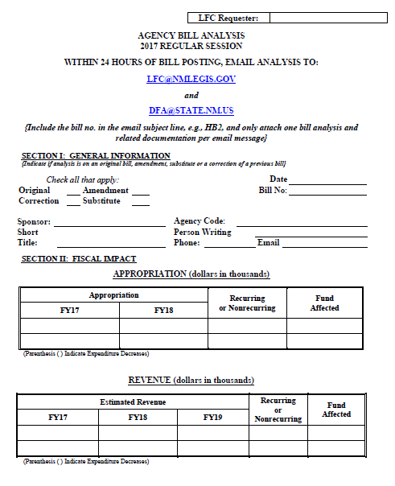
AGENCY FIR ANALYSIS FORM

Slide 8
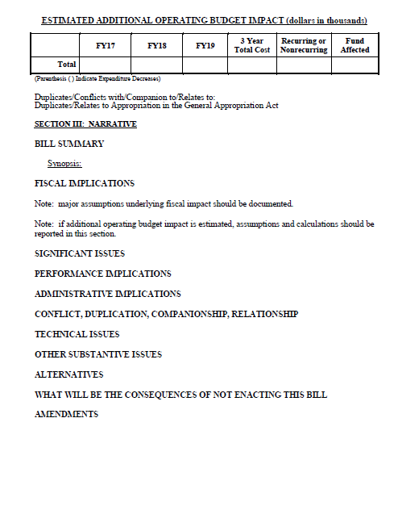
AGENCY FIR ANALYSIS FORM

Slide 9
PROCESS
TABLES
  APPROPRIATION
  REVENUE
  ESTIMATED OPERATING BUDGET IMPACT
    CAN BILL BE IMPLEMENTED WITH THE STATED APPROPRIATION?
    ARE THERE INCREASED EXPENDITURES FOR THE OUTYEARS?
    DISCUSS UNDER FISCAL IMPLICATIONS

Slide 10
PROCESS
BILL SUMMARY
  DISCUSS HOW AGENCY INTERPRETS THE BILL
FISCAL IMPLEMENTATION
  DISCUSS OUTYEAR COSTS
  HB 560 (Laws 2016, Ch. 152) resulted in a request for $2.5 million appropriation increase

Slide 11
PROCESS
SIGNIFICANT ISSUES
  DISCUSS IMPLEMENTATION OF BILL, EXPECTED RESULTS, ANTICIPATED PROBLEMS, ETC
  BRIEFLY DESCRIBE SIGNIFICANT ISSUES
  ARE THERE UNINTENDED CONSEQUENCES RELATED TO THE BILL?

Slide 12
PROCESS
PERFORMANCE IMPLICATIONS
  HOW WILL IMPLEMENTATION BE EVALUATED
  GENERAL COMMENTS—DO NOT NEED SPECIFICS
CONFLICT, DUPLICATION, COMPANIONSHIP, RELATIONSHIP
  ARE THERE OTHER BILLS RELATED TO THIS ONE?
  GOAL IS TO AVOID CONFLICTS

Slide 13
PROCESS
REMAINDER OF HEADINGS ARE OPTIONAL
NOTE USE TECHNICAL ISSUES FOR CORRECTIONS WITHIN THE BILL
USE AMENDMENTS FOR SIGNIFICANT CHANGES TO THE BILL; PROVIDE JUSTIFICATION

Slide 14
PROCESS
BILLS AMENDING STATUTE
  ONLY NEED TO ASSESS THE IMPACT OF THE CHANGE; NOT THE COMPLETE SECTION OR CHAPTER
  DISCUSS THE CHANGE IN CONTEXT
NEW STATUTE
  FIR MUST COVER ENTIRE BILL

Slide 15
PROCESS
LFC ANALYSTS WILL SUMMARIZE INPUTS
IF YOU FEEL AGENCY INPUT IS MISREPRESENTED, CALL IMMEDIATELY!

Slide 16
LFC CONTACTS
GARY CHABOT, 986-4550
JEANNAE LEGER, 986-4543
JESSICA EDEN, 986-4549
APPROPRIATE ANALYST, 986-4550
LAST RESORT
  DAVID LUCERO, 986-4550
  DAVID ABBEY, 986-4550

Slide 17
FIR TRAINING
QUESTIONS??
COMMENTS??

